Slide 1


PHYS 7810 - Computational statistical physics
Boltzmann generators: Efficient sampling of equilibrium states of many-body system with deep learning
Final Project Presentation
Date: 04.23.2020
Lecturer: Dr. Matt Glaser
Presenter: Wei-Tse Hsu and Lenny Fobe
Department of Chemical and Biological Engineering, University of Colorado Boulder
Notes:
Good morning, everyone, my name is Wei-Tse Hsu and I’m in the same group with Lenny Fobe. Today, we are going to introduce you our final project for this class, which is utilizing Boltzmann generators to perform efficient sampling of equilibrium states of many-body system with deep learning.

Slide 2
Outline
Introduction
Applications of Boltzmann generators
Challenges of sampling equilibrium states
Architecture of a Boltzmann generators
Flow-based generative models
Real-valued non volume-preserving (RealNVP) transformation network
Affine coupling layers in an NVP block
Loss functions for training
Systems of interest
Double-well potential
Muller Brown potential
Dimer in Lennard-Jones bath
Acquisition of training datasets
Training of the inverse generator
Free energy calculations
1
Notes:
In the first half of this presentation, I will introduce you the challenges ahead when we sample the configurational space of molecular system, the basic ideas of Boltzmann generator and how we build and train them. Since the math behind the deep learning model could be kind of complicated, here, I will try to walk you through with the minimal math required to understand the core concept of a Boltzmann generator. Then, we will talk about the applications of Boltzmann generators and how we applied them to different simple systems to sample the equilibrium states. I will briefly walk you through the first simplest toy model, which is the double-well potential. Then, Lenny will talk about how he apply the method to more complicated systems, including Muller Brown potential and a dimer in a Lennard-Jones bath.

Slide 3
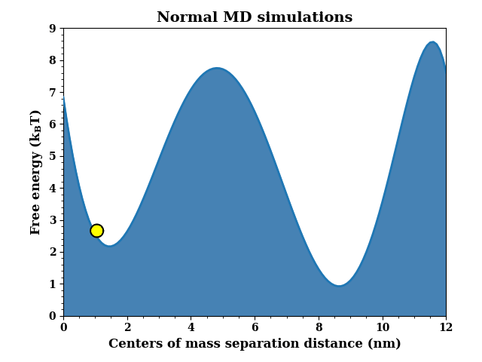
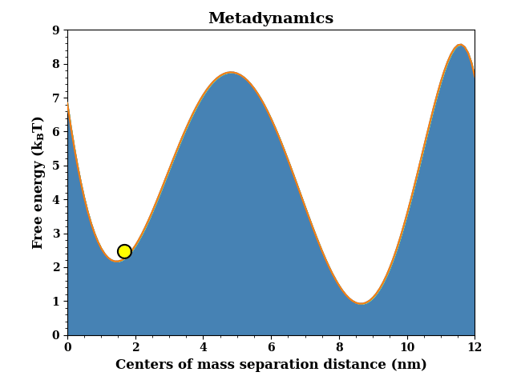
Introduction
The usefulness of molecular simulations (MC or MD simulations) is limited in systems with slow kinetics
Large free energy barriers between metastable states cause kinetic bottlenecks.
Advanced sampling methods
Metadynamics and its variations
Umbrella sampling
Replica exchange, or expanded ensemble
Boltzmann generators
Bound
Unbound
2
Notes:
As we’ve already learned from this class in this semester, molecular dynamics simulations and Monte Carlo simulations could be very powerful tools that provide us some insights into the system of interest without requiring us to really do experiments. However, as you might already know, the usefulness of molecular simulations is restricted by a system characterized by numerous metastable states separated by really high energy barriers.
For example, as you can see in the animation, in a protein-ligand binding complex, the bound state and the unbound state are typically the regions of our interest which we want sample over in a simulation. However, if there is a really high energy barrier between these two metastable states, then the system would spend most of the time being trapped in the bound state and we can barely reach the unbound state within reasonable time. Or we can say that, under this kind of situation, it is really hard to generate a configuration in the other metastable state sampled from the Boltzmann distribution.
In the past decades, various computational methodologies are developed in attempt to alleviate this time-scale issue. The majority of them can be classified as advanced sampling methods, which are methods that manipulate the principles of thermodynamics and statistics to accelerate the sampling process. For example, as you can see in the animation, metadynamics, as one of the most popular kinds advanced sampling techniques, apply Gaussian potentials to compensate the basins of the free energy system such that the system is able to sample other metastable states. There are also other kinds of methods like umbrella sampling, which applies a force on a part of the system to generate a bunch of configurations at different values of reaction coordinates. All of these configurations are pinned by a harmonic restraints. After we got the probability distribution of each configuration, we use statistical methods such as MBAR to stitch these distributions. Also, there are another class of methods that take advantages of a series alchemical intermediate states to bridges the gap in the probability overlap between different states. These methods include replica exchange molecular dynamics, expanded ensemble and their variations.
And today, the method that we are going to talk about in this presentation, a Boltzmann generator, is very different from all of these methods. Instead of still requiring running molecular dynamics simulations, Boltzmann generators completely relies on the power of deep learning given a reasonable training dataset. Now, in the first half of the presentation, let me show you the basic ideas of a Boltzmann generator, and how we implemented this amazing method.

Slide 4
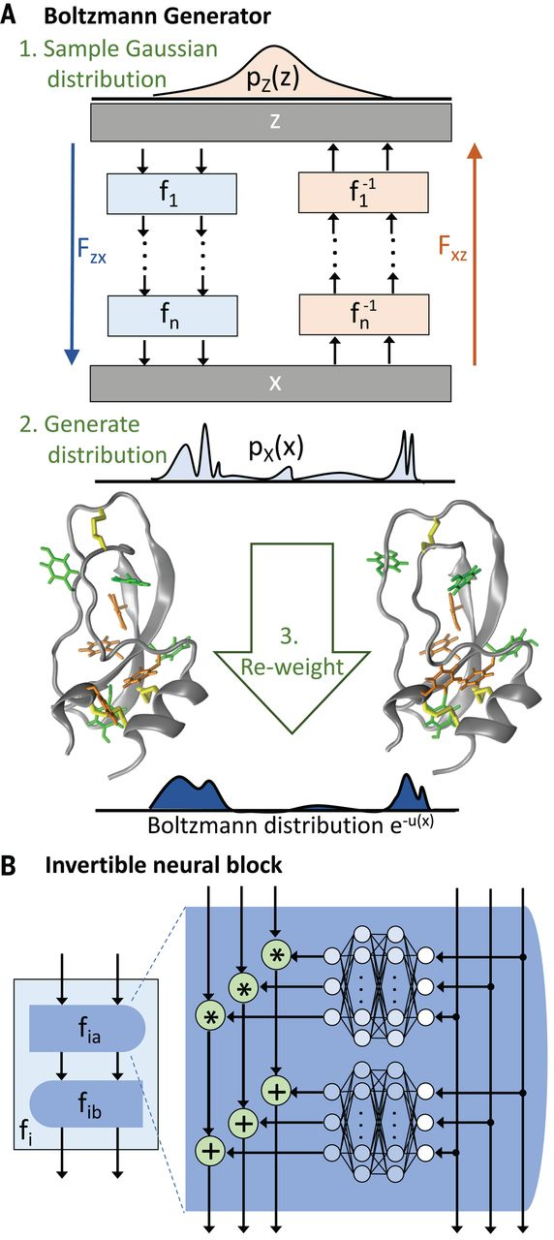

Introduction
A Boltzmann generator is trained to learn the transformation between probability distributions in the configuration and the latent space
Goal: approximate the Boltzmann distribution
Procedures to generate $p_{x}(x)$
Taking the samples in the real space as the input
Train the inverse generator $F_{xz}$ with samples $x$
Draw samples from the latent space
Map the latent samples back to the configuration space
?
Generator
Inverse
generator
3
Notes:
So, what is a Boltzmann generator used for? We all know that the Boltzmann distribution is often used to describe the distribution of particles over energy states accessible to them and it could be difficult to draw independent configurations from the Boltzmann distribution. The goal of a Botlzmann generator, is to approximate the Boltzmann generator by learning a mapping between two probability distributions.
What does that mean? Specifically, as you can see in the figure. X is the configuration space or the real space, which is the space that our configurations of interest come from. At the beginning, we don’t know how the Boltzmann distribution of this system looks like, although we do have some samples in the space x. Then, in a Boltzmann generator, we define another artificial distribution, which is called the latent space distribution. This latent space distribution, as noted as pz of z in the figure, can be an arbitrary distribution but is typically a Gaussian distribution which has the same dimensionality as the configuration space. And as I said, the goal of a Boltzmann generator, is to generate configuration sampels in the real space by learning how to transform samples between theses two different spaces. As you can see in the figure, so the mapping from the latent space to a real space, is done by a generator, while the mapping from the real space to a latent space is done by an inverse generator.
So that sounds pretty fantastic! But the question is, how do we do that? Basically, with these two kinds of different spaces, we use a Boltzmann generator to generate px of x in the real space as follows.
First of all, although we don’t know how px of x looks like, we do know how to draw samples from this distribution. Specifically, even if MD and MC simulations are not perfect, we can still use them to sample a part of the configuration space to generate a dataset for us the train the Boltzmann generator. So as you can see, the first step, is to take samples from the real space and use them as the training dataset.
Then, we apply an inverse generator Fxz to these input samples and transform these samples from the real space, to a Gaussian distribution in the latent space. As you can see in the figure, this inverse generator is composed of several blocks, which are called NVP blocks. Each of these blocks is a neural network composed of several deep learning layers. To make sure that our samples in the real space will be reasonably mapped to the latent space, during the process, the quality of the inverse generator will be improved as the neural networks are being trained.
Because all the functions used in the inverse generator are invertible, which means that the relevant matrices are all invertible. If these functions are properly designed, once the inverse generator is trained, we can easily get the generator. As you would imagine, an generator transforms samples in the latent space back to the real space, so apparently the third step when using a Boltzmann generator, is to draw samples from the Gaussian distribution from the latent space. Then, given these example, we use the generator to generate configurations transforming the samples in the latent space. This probability distribution px of x is not exactly the Boltzmann distribution but just an approximaiton and is what we want from a Boltzmann generator.

Slide 5














Introduction
Boltzmann generators are a application of flow-based generative models
$F_{xz}$ and $F_{zx}$ are composed of “a flow of” non volume-persevering (NVP) blocks.
The volume of space is changed between different spaces within the flow.
4
Notes:
In the previous slide, I just showed you that a generator and an inverse generator are both composed of a series of NVP blocks. As you can see in the figure, now we take the generator as an example, this generator starts from a bunch of samples z_0 which are drawn from a Gaussian distribution in the latent space. To generate a probability distribution x to approximate the Boltzmann generator, we need to transform our input distribution little by little by introducing a series of intermediate probability distributions. As you can see, we use the first NVP block, which is the function f1, to transform probability distribution z_0 to z1, which is another probability distribution. To transform from a distribution to another, one thing that we have to keep an eye on is that the volume of space also changes between different spaces. Therefore, we have to multiply the original probability by a factor which accounts for this change in the volume space. This factor, as you can see in the equation, is the determinant of the inverse Jacobian of the transformation function. As we stack a series of NVP blocks, the input probability distribution gets transformed and all the determinant of the inverse Jacobian of each transformation function are multiplied. Therefore, if we transform pz of z to px of x, we know that px of x is pz of z times the determinant of inverse Jacobian of the generator Fzx. Applying log function and the inverse function theorem to the whole equation, we can get this equation, where Rxz now is represented the determinant. Basically, this is an important governing equation we used to derive the loss functions used for training model.

Slide 6

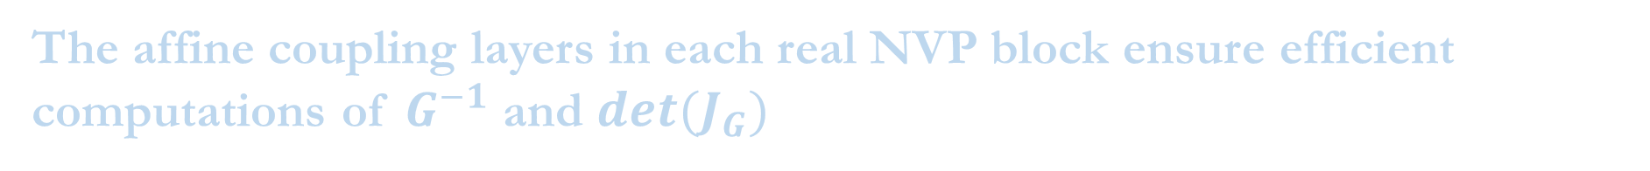
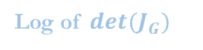
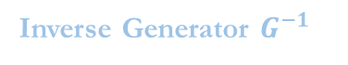
Introduction
The affine coupling layers in each real NVP block ensure efficient computations of $G^{−1}$ and $det(J_{G})$
Inverse Generator $G^{−1}$
Log of $det(J_{G})$
Each affine coupling layer performs a scale-and-shift transformation
(Channel 1: copy)
(Channel 2: transform)
5
Notes:
As we just showed, this is the underlying equation of the Boltzmann generator, so let’s take a closer look it. Apparently, px of x is what we want, and we only have samples in the configuration space, which is the variable x. From this equation we can know that log px of x can be calculated by adding up two logarithmic terms. The first one is the log of the probability of the inverse generator, while the other one is the determinant of the inverse generator. Since this equation is only related to the inverse generator, this equation implies that the accuracy and the efficiency of the Boltzmann generator are all depends on how we train the inverse generator. To ensure that The Boltzmann generator is computationally cheap, we have to make sure that the computation of inverting the transformation function in the inverse generator and the determinant of the inverse generator have to be efficient.
However, how do we make sure that both of these computations are efficient?

Slide 7
Introduction
The ordering of the two channels in a layer is reversed after each iteration
Each affine coupling layer performs a scale-and-shift transformation
(Channel 1: copy)
(Channel 2: transform)
Channel 1: transform
Channel 1: transform
Channel 1: copy
Channel 1: copy
Channel 1
x
+
x
+
S
T
S
T
S
T
S
T
Channel 2
x
+
x
+
Channel 2: transform
Channel 2: copy
Channel 2: transform
Channel 2: copy
6
Notes:
The ordering of the two channels in a layer is reverse after each iteration

Slide 8
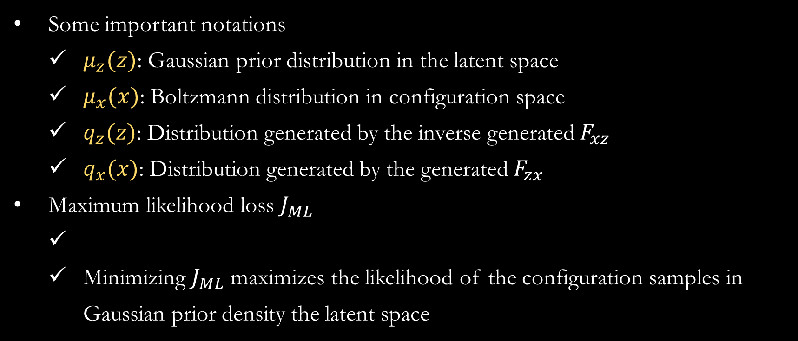
Introduction
Minimization of the loss functions ensure the robustness of the network
Some important notations
$μ_{z}(z)$: Gaussian prior distribution in the latent space
$μ_{x}(x)$: Boltzmann distribution in configuration space
$q_{z}(z)$: Distribution generated by the inverse generated $F_{xz}$
$q_{x}(x)$: Distribution generated by the generated $F_{zx}$
Maximum likelihood loss $J_{ML}$
Minimizing $J_{ML}$ maximizes the likelihood of the configuration samples in Gaussian prior density the latent space
Notes:
Kullback–Leibler
First term and second term

Slide 9

Introduction
Reaction coordinate loss promote the sampling of high-energy states in a specific direction of configuration space
Reaction coordinate loss $J_{RC}$
Given a predefined RC,
Kullback-Leibler likelihood loss $J_{KL}$
KL divergence $D_{KL}(p||q)$ measures the distance between distribution $p$ and $q$
In the latent space:
In the configuration space:
Total loss:

Slide 10
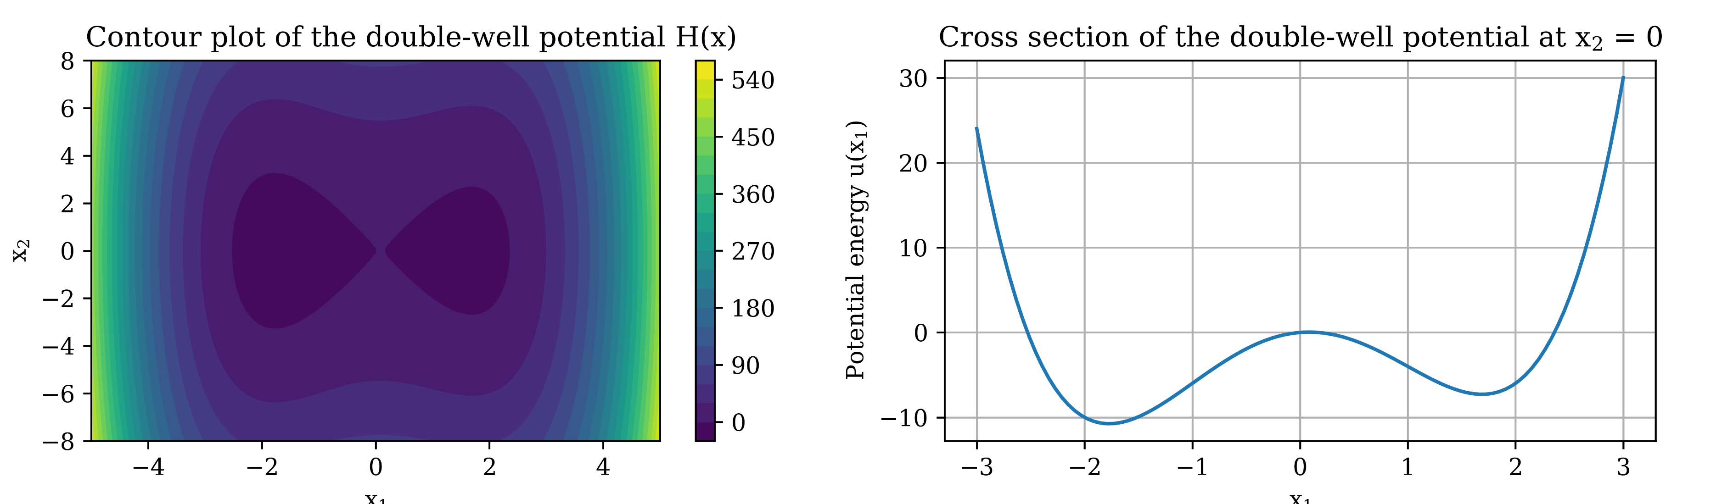
Applications of Boltzmann generators – System 1: Double-well potential
We started with double-well potential to construct Boltzmann generators
Goals for the system:
Generate samples at both metastable states and compute the free energy difference.
Plot the free energy profile as a function of the reaction coordinate.
Assess the Boltzmann generators trained on different loss functions.

Slide 11
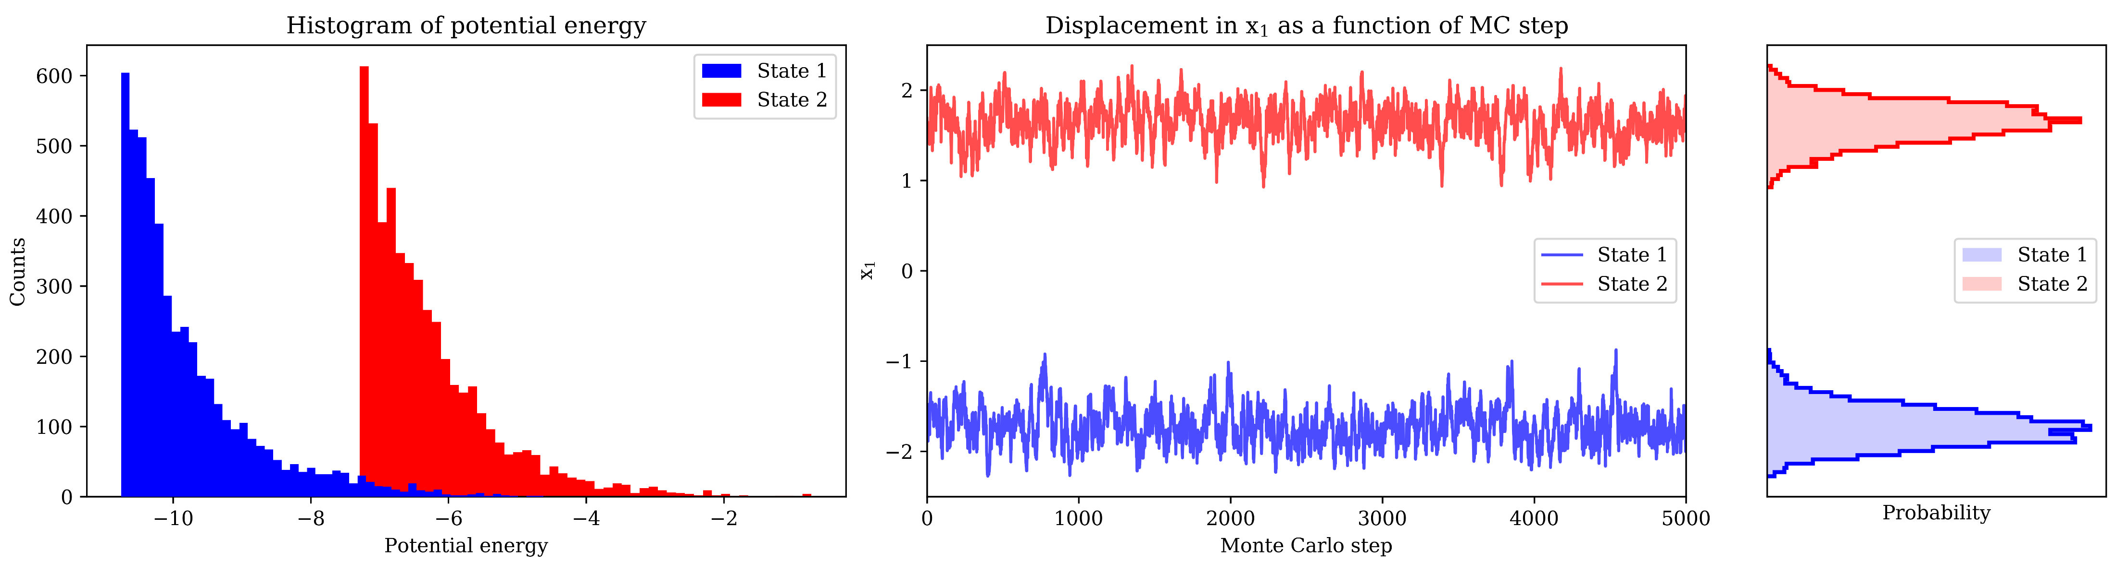
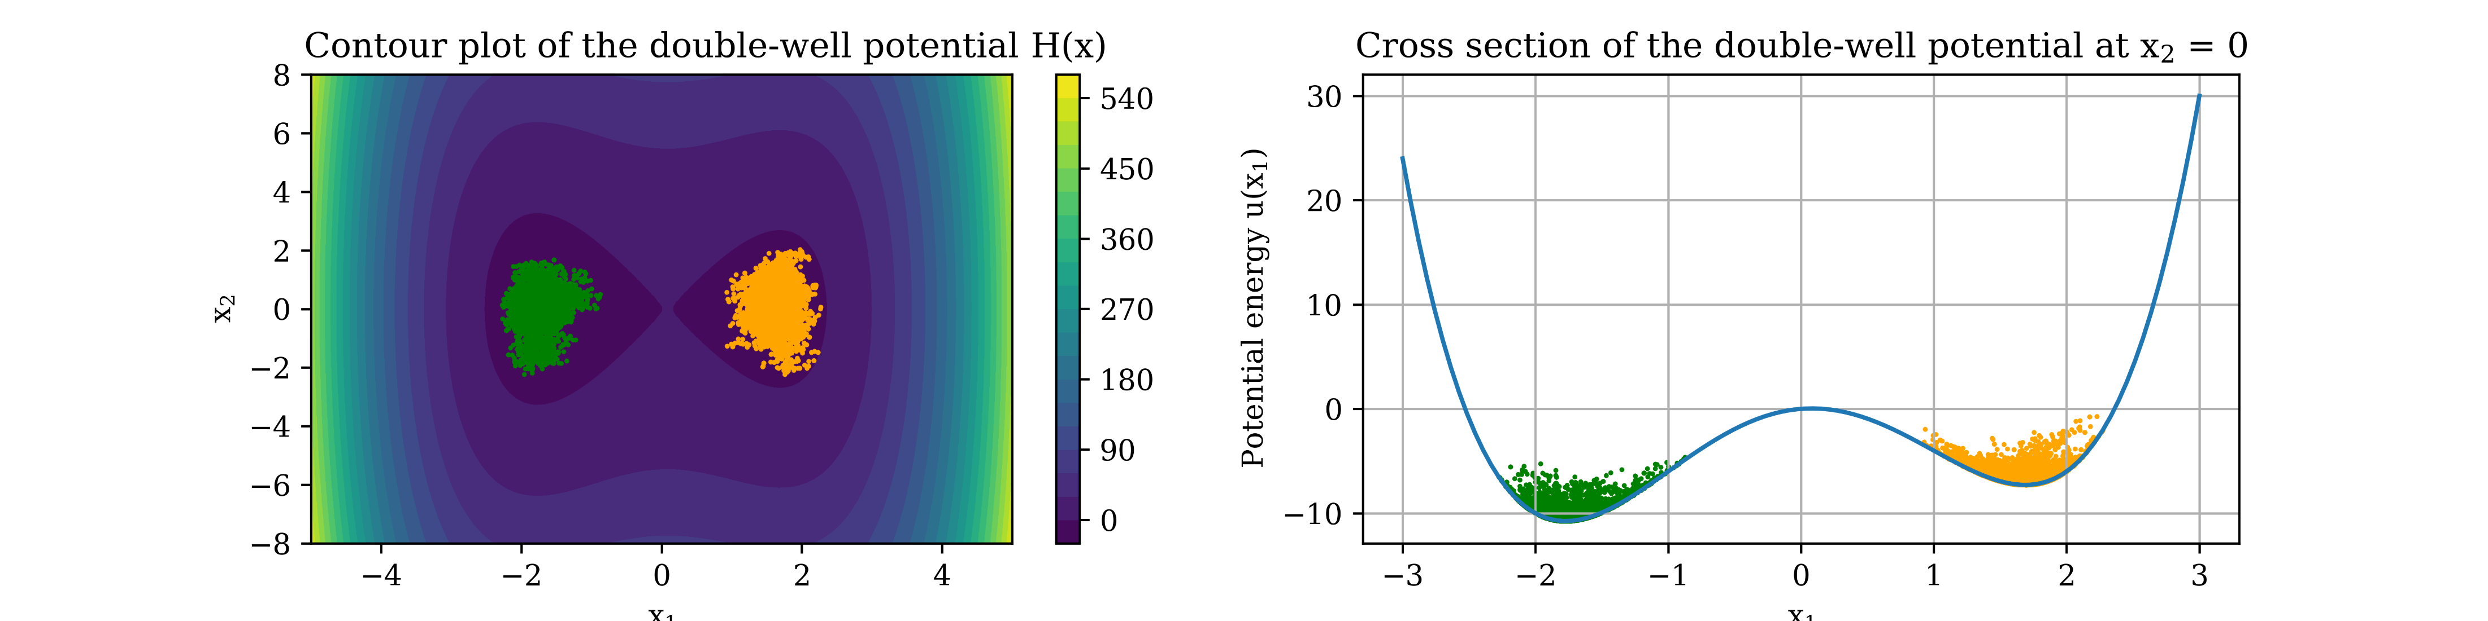
Applications of Boltzmann generators – System 1: Double-well potential
We extracted configuration samples from each energy minima using Monte Carlo (MC) simulations
5000 samples for each minimum

Slide 12
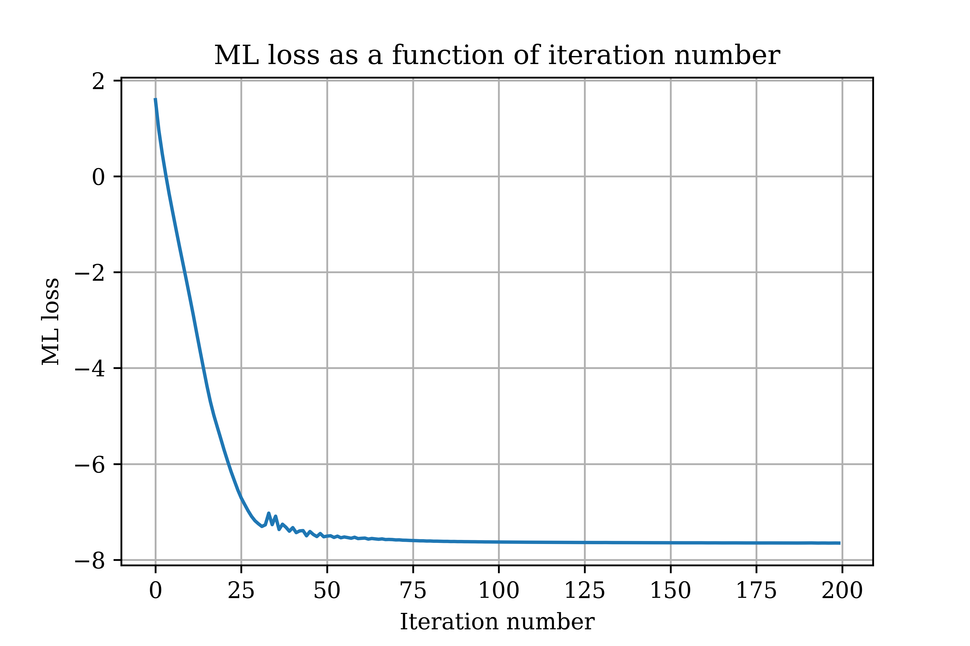
Applications of Boltzmann generators – System 1: Double-well potential
Boltzmann generators trained on ML loss function was able to generate reasonable configurations in the real space
Parameters
3 NVP blocks
3 layers per each NVP block
100 nodes per each layer
Activation functions: ReLU and tanh
Optimizer: Adam, with LR as 0.001
Batch size: 1000 samples
Number of iterations: 200

Slide 13
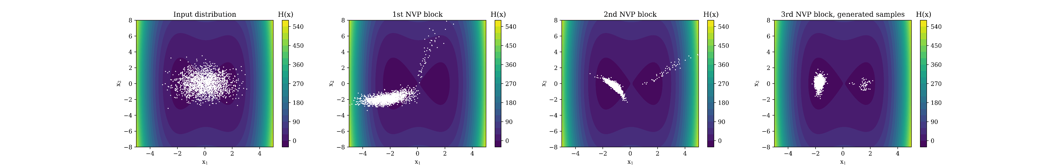
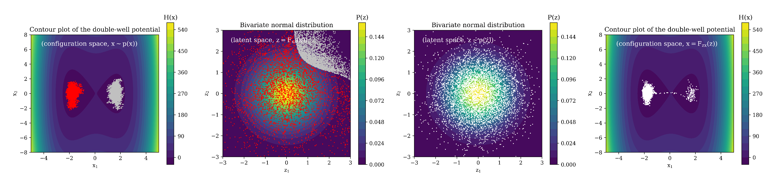
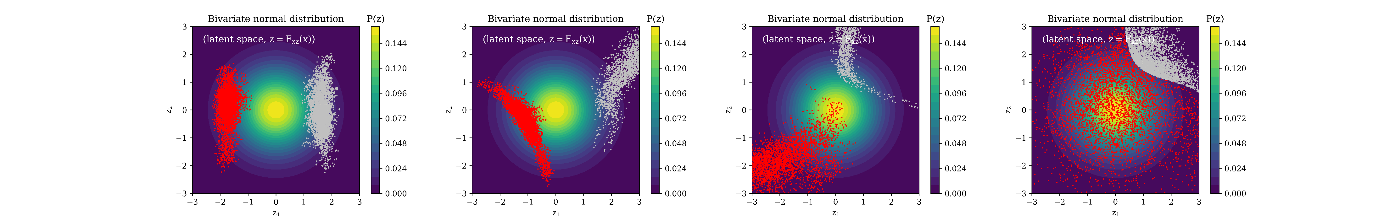
Applications of Boltzmann generators – System 1: Double-well potential
Boltzmann generators trained on ML loss function was able to generate reasonable configurations in the real space

Slide 14
Applications of Boltzmann generators – System 1: Double-well potential
KL divergence, hyperparameters

Slide 15
Applications of Boltzmann generators – System 1: Double-well potential
ML + KL loss

Slide 16
Applications of Boltzmann generators – System 1: Double-well potential
With Boltzmann generators, we are able to compute free energy as a function of a reaction coordinate

Slide 17
Applications of Boltzmann generators – System 1: Double-well potential
Statistical weights improve the quality of free energy estimation

Slide 18
Applications of Boltzmann generators – System 1: Double-well potential
Future work
Latent space interpolation

